Slide 1

Medicine Inventory System
Database Management Project
Mohammad Omar 231002343
Omnia Abdelnaser Ezzat 211000476
Mariam Ashraf Bassaly 231002049
Mohammad Ahmed Atea 231002184
Supervised by: Dr. Muhammad Elsayeh

Slide 2
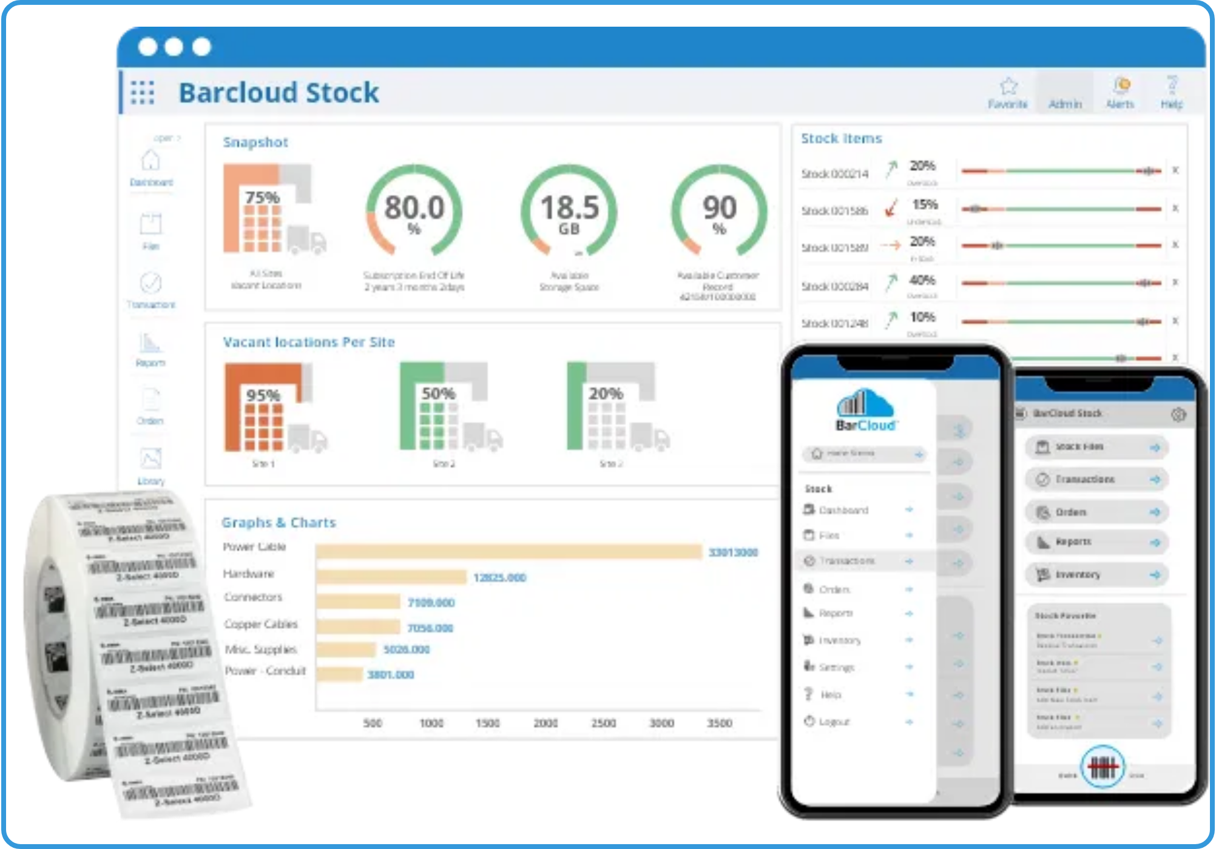




Mohammad Omar 231002343
Project Overview
This project is a Relational Database Management System for medical inventory, bringing together doctors, diseases, medicines, prescriptions, and billing in one organized platform. It enables quick access to information, reduces errors, and improves work efficiency.
Relational database management system for medical inventory
Tracks medicines, their associations with diseases, and prescription details
Manages doctor information and their prescriptions
Automated billing system with tax calculation and discounts

Slide 3

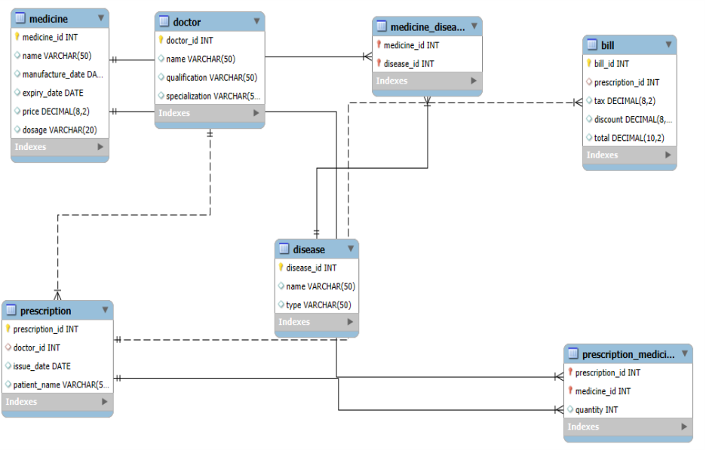
Mohammad Omar 231002343
SQL Schema

Slide 4

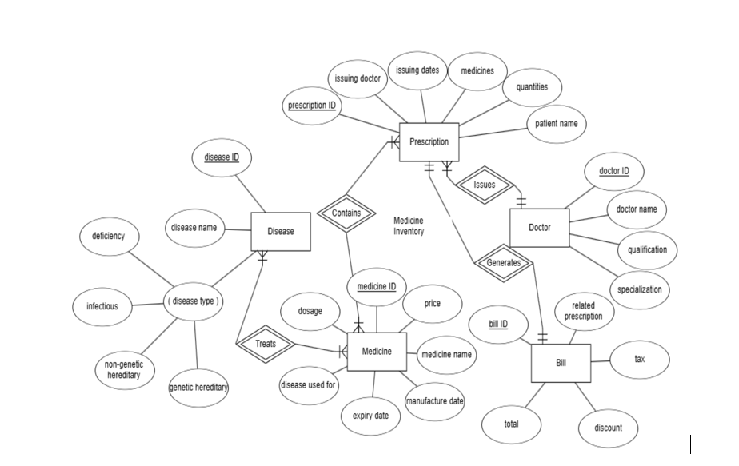
Mohammad Omar 231002343
Database Schema: Key Entities
ER Diagram
Records medicine details: ID, name, manufacture/expiry dates, price, and dosage.
Links doctors to patients with prescription ID, doctor ID, issue date, and patient name.
Handles financial aspects with bill ID, prescription ID, tax, discount, and total amount.

Slide 5


Mohammad Omar 231002343
SQL Implementation: Structure & Data
Data Definition Language (DDL)
Used to define the database structure through CREATE statements.
CREATE TABLE
Medicine (
medicine_id INT PRIMARY KEY,
name VARCHAR(100),
manufacture_date DATE,
expiry_date DATE,
price DECIMAL(10,2) CHECK (price >= 0),
dosage VARCHAR(50)
);
Data Manipulation Language (DML)
Used to populate tables with initial data through INSERT statements.
INSERT INTO
Doctor VALUES
(1, 'Dr. Rowaida', 'MBBS, MD', 'Heart Disease'),
(2, 'Dr. Mohab', 'MBBS', 'Dermatology'),
(3, 'Dr. Abdullah', 'MBBS, MS', 'Neurology');

Slide 6
Omnia Abdelnaser Ezzat 211000476
Advanced Features: Stored Procedures
recalc_bill_proc
A stored procedure that automatically recalculates the bill total for a given prescription ID, including tax calculation.
1
Calculate subtotal by summing (quantity × price) for
all medicines in the prescription
CREATE PROCEDURE
recalc_bill_proc (IN pid INT)
BEGIN
DECLARE subtotal DECIMAL(12,2) DEFAULT 0.00;
SELECT IFNULL(SUM(pm.quantity * m.price),0.00) INTO subtotal
2
Apply 5% tax to the subtotal
FROM Prescription_Medicine pm
JOIN Medicine m ON pm.medicine_id = m.medicine_id
WHERE pm.prescription_id = pid;
3
Calculate final total (subtotal + tax - discount)
UPDATE Bill
SET tax = ROUND(subtotal * 0.05,2), -- 5% tax
discount = 0.00,
4
Update the Bill table with the new values
total = ROUND(subtotal + ROUND(subtotal * 0.05,2) - 0.00,2)
WHERE prescription_id = pid;
END

Slide 7



Mohammad Atea 231002184
Advanced Features: Triggers
trg_after_insert_prescription
Creates a new bill record when a prescription is added and calculates its initial total.
trg_after_insert_prescription_medicine
Recalculates the bill when a new medicine is added to a prescription.
trg_after_update_prescription_medicine
Recalculates the bill when a medicine's quantity or type is updated in a prescription.
trg_after_delete_prescription_medicine
Recalculates the bill when a medicine is removed from a prescription.
Trigger Workflow
Data Change
→
Trigger Activated
→
Call Procedure
→
Bill Updated

Slide 8
Mariam Ashraf Bassaly 231002049
Practical Applications: Sample Queries
1. List Heart Disease Specialists
Query to find all doctors specializing in heart disease.
SELECT
name
FROM
Doctor
WHERE
specialization = 'Heart Disease';
Results: Dr. Rowaida, Dr. Mariam, Dr. Nada
2. List Deficiency Diseases
Query to identify all diseases categorized as deficiency type.
SELECT
name
FROM
Disease
WHERE
type = 'Deficiency';
Results: Anemia, Scurvy, Rickets

Slide 9





Mariam Ashraf Bassaly 231002049
Technologies & Conclusion
Technologies Used
Benefits & Future Enhancements
MySQL Database Management System
Automated billing with real-time updates
SQL (DDL, DML, Stored Procedures, Triggers)
Comprehensive medicine-disease relationship
tracking
Relational Database Design
Data integrity through triggers and constraints
Future: Inventory alerts for expiring medicines
Future: Patient history and analytics dashboard

Slide 10




Thank You!
Questions & Discussion
Mohammad Omar | Omnia Abdelnaser Ezzat | Mariam Ashraf Bassaly | Mohammad Ahmed Atea
Supervised by: Dr. Muhammad Elsayeh

